Slide 1
Title
Company Logo is acceptable
on the Title Page
The Slide Aspect Ratio
Should be 16:9
Author
Company Name
Presented at Event Name and Date.
Note: the PSMA logo should be in the bottom right corner on all slides. ->
Copyright notice (if used) can go here
Notes:
All of these slides serve as a suggestion only, not a requirement for Industry Session or other PSMA-related presentations. The PSMA logo should be in the bottom right of all slides, if the one shown here does not fit the presenter’s template other logos can be found at https://www.psma.com/art/PSMA-logo/PNG-Format-Office-Use/
Company logos, if part of the presenter’s template, can be used on slides other than the title slide.

Slide 2
Presenters Bio – on second page Be Sure to Include a Picture Company Logo is also approved for this page.
This would be skipped during a typical presentation because the host would introduce the speaker and cover the bio highlights.
The bio is primarily intended for those that access the file independently.
Copyright notice (if used) can go here

Slide 3
Presentation Content Suggestions – FORMAT INTENDED FOR 20 - 30 MIN PRESENTATION
Why does this topic important / Introduction? (1-2 slides)
Current Status(1-2 slides)
Analysis/Approach (1-2 slides)
Solution (~10 slides)
Summary Findings/Conclusion (1-2 slides)
Questions remaining, Other challenges to address, (1 slide)
Conclusion (1-2 slides)
This format can be used for PSMA Industry Session and Workshop presentations
Copyright notice (if used) can go here
Notes:
This is just a suggested format for the presentation and is intended as a guideline for presenters unsure of how to structure their presentation. Other structures are allowed and should be tailored to fit the presenter’s message and style.

Slide 4
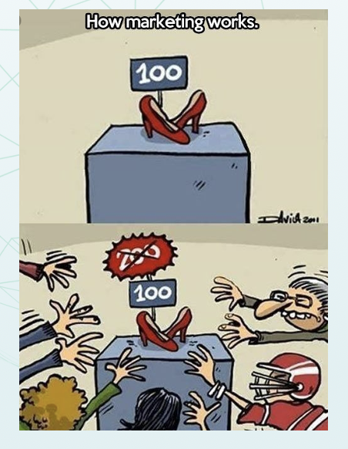
Intro Suggestion: Cool Diagram or Picture Covering the Topic on one Slide
Copyright notice (if used) can go here
Notes:
Although not required, a slide deck that is completely or mostly text can make it hard for the audience to engage. Add graphics, diagrams, etc. as appropriate.

Slide 5
Why This Topic Matters
Reason 1
Reason 2
Etc.
Copyright notice (if used) can go here
Notes:
The idea behind this and the next several slides is to suggest a flow of information. Again, this is useful for presenters who are unsure how to structure their presentation and is not required.

Slide 6
Current Status
Content describing the current state of the marketplace
Copyright notice (if used) can go here

Slide 7
Analysis/Approach
Content describing how you approached the issue

Slide 8
Solution
Content describing the solution and how you got there
Copyright notice (if used) can go here

Slide 9
Summary Findings/Conclusion
Content describing the success of the solution
Copyright notice (if used) can go here

Slide 10
Questions Remaining/Other Issues to Address
Content describing what else needs to be addressed going forward
Copyright notice (if used) can go here

Slide 11
Conclusion
Wrap up the presentation, an interesting graphic could be used again. Recommendations can be presented here as well.
Copyright notice (if used) can go here
Notes:
The wrap up slide(s) should concisely summarize what was presented and (if applicable) offer recommendations going forward.

Slide 12
Thank you for your interest.
By, Author
Email: Author
Phone: Author
Committee/Session Name
Company Logo is acceptable on this slide
Copyright notice (if used) can go here
Notes:
The thank you slide should contain reiterate the presenter’s name and contact information.

